Slide 1


Automatic Retinopathy Detection Using Digital Image Processing via a Smart Device
JOEY TATÚ
15015556
joey.tatu@student.ncirl.ie
MAY 2021

Slide 2


Navigation
Video 1:
Introduction
Project Overview
Technologies
Testing & evaluation
Video 2:
System demonstration
Code walkthrough
Video 3:
Questions & answers
Showcase poster
Image: Royalty free
Slides with thanks to Microsoft

Slide 3

Introduction
DESCRIPTION:
JOEY TATÚ
BSc (HONOURS) IN COMPUTING
SOFTWARE DEVELOPMENT
PROJECT:
AUTOMATIC RETINOPATHY DETECTION USING DIGITIAL IMAGE PROCESSING VIA A SMART DEVICE
Image: Tatú, 2019

Slide 4
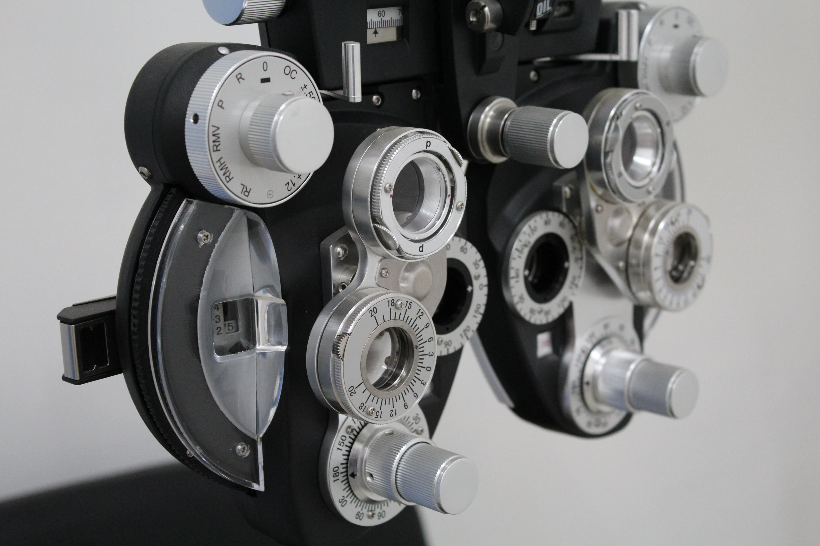
Overview
WHAT?
Diabetic retinopathy
Android app - Detect diabetic retinopathy
Compare with model
WHO?
Opticians / ophthalmologists
Untrained medical staff
Free up time for eye doctors
How?
Many research articles
Very basic apps
Image: Royalty free

Slide 5








Technologies

Slide 6
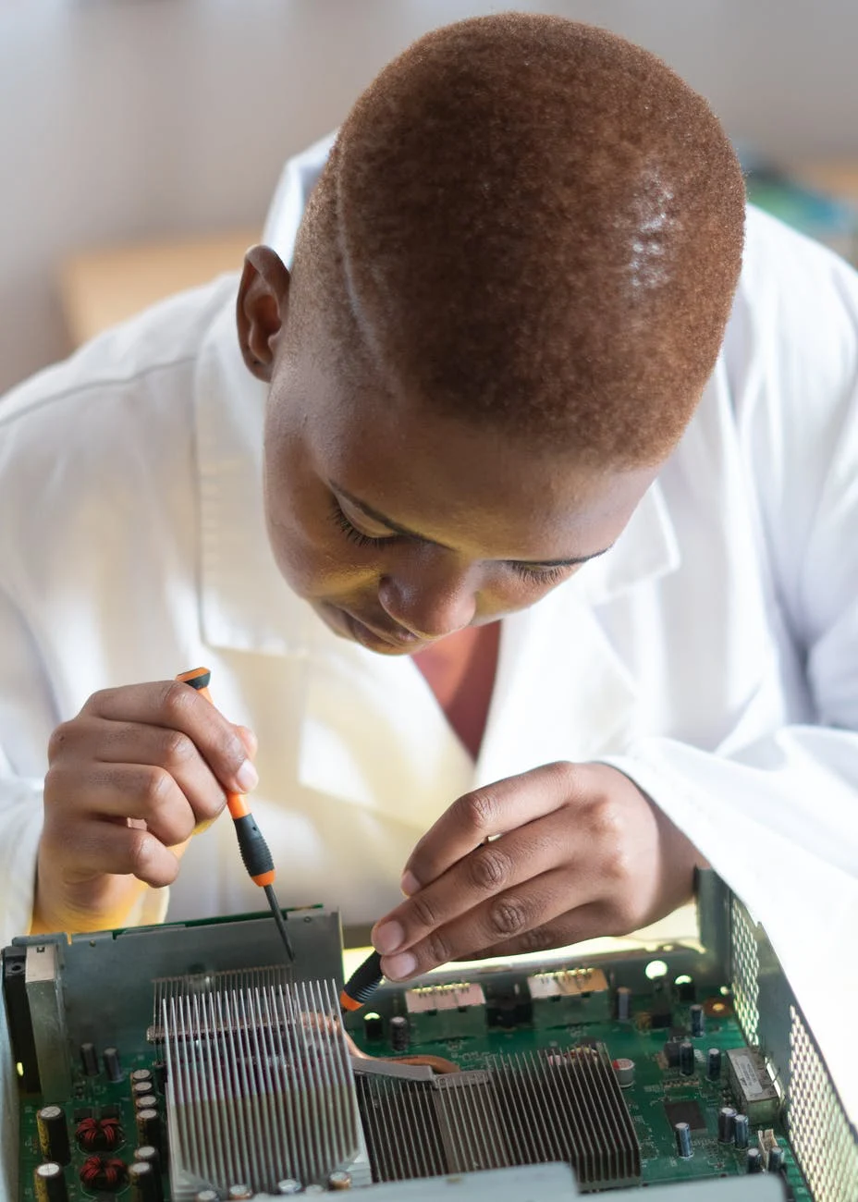
Testing & Evaluation
Usability testing:
Jakob Nielsen's 10 general principles for interaction design.
Visibility of system status
Match between system and the real world
User control and freedom
Consistency and standards
Error prevention
Recognition rather than recall
Flexibility and efficiency of use
Aesthetic and minimalist design
Help users recognize, diagnose, and recover from errors
Help and documentation
Image: Royalty free

Slide 7
Testing & Evaluation
Junit 5
Performance testing:
Login Activity to Patient Activity using Google login: 2.203 seconds. (excluding web browser activity)
Login Activity to Patient Activity using Facebook login: 2.958 seconds. (excluding web browser activity)
Patient Activity to Image Activity: 0.694 seconds.
Load & stress testing:
90% RAM/Memory in use
Activities had a max increase of +1.826 seconds (exception of Image to results - +2.947 seconds)
Image: Royalty free

Slide 8
Testing & Evaluation
Endurance testing
Like Load & stress testing
Ran for 24 hours at 90% RAM
Similar results, but ±0.500 seconds
Spike testing:
90% RAM in use for 10 minutes
Every 30 minutes interval for 24 hours.
Similar results, but ±0.125 seconds
Image: Royalty free

Slide 9
Testing & Evaluation
Volume testing
App created for device
Consistency send and receive data every 10 seconds
Results Activity duplicated into new app
Would update record every 30 seconds
Free tier database full after 9h 34m
Last 15 minutes before full
Results page loading increased to +10.797 seconds
Image: Royalty free

Slide 10
Navigation
Video 1:
Introduction
Project Overview
Technologies
Testing & evaluation
Video 2:
System demonstration
Code walkthrough
Video 3:
Questions & answers
Showcase poster
Image: Royalty free

Slide 11






System Overview
Image: Royalty free

Slide 12

Code Overview
Image: Royalty free

Slide 13
Navigation
Video 1:
Introduction
Project Overview
Technologies
Testing & evaluation
Video 2:
System demonstration
Code walkthrough
Video 3:
Questions & answers
Showcase poster
Image: Royalty free

Slide 14

Questions & Answers
Discuss the most difficult aspect of your project with particular emphasis on those areas related to your chosen specialisation
Discuss the most innovative aspect of your project. For example, with respect to your use of technologies, programming languages, frameworks or security protocols etc.
With respect to your requirement specification, what requirements have you since added, removed or changed and what impact has this had on the completeness of your project?
Describe in detail, your approach to Testing
If you were to start your project again, would you change any of the decisions you made? For example, in relation to tools, technologies, languages, algorithms, security, testing strategies etc.
Image: Royalty free

Slide 15
Showcase Poster
Showcase poster is also available via Turnitin and also by clicking here.
Showcase Poster created in Microsoft PowerPoint. With thanks to Microsoft.

Slide 16
Thank You!
JOEY TATÚ
15015556
joey.tatu@student.ncirl.ie
MAY 2021

